Slide 1

Oracle11g:
PL/SQL Programming
Chapter 2
Basic PL/SQL
Block Structures

Slide 2
Chapter Objectives
After completing this lesson, you should be able to understand:
  Programming fundamentals
  PL/SQL blocks
  How to define and declare variables
  How to initialize and manage variable values
  The NOT NULL and CONSTANT variable options
Oracle11g: PL/SQL Programming

Slide 3
Chapter Objectives (continued)
After completing this lesson, you should be able to understand (continued):
  How to perform calculations with variables
  The use of SQL single-row functions in PL/SQL statements
  Decision structures: IF-THEN and CASE
  Looping actions: basic, FOR and WHILE
  CONTINUE statements
  Nested Statements
Oracle11g: PL/SQL Programming

Slide 4
Program Logic Flow
Identify sequence of actions needed prior to coding
Use a flowchart to visually represent the sequence of actions
Oracle11g: PL/SQL Programming

Slide 5
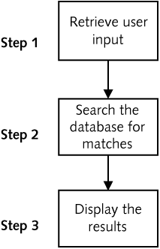
Flowcharting - Search for Coffee Products
Oracle11g: PL/SQL Programming

Slide 6
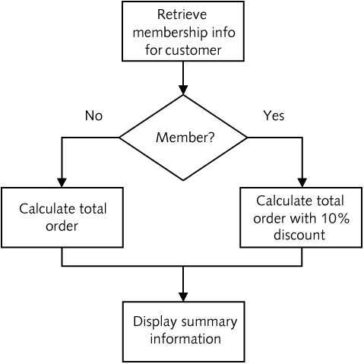
Decision Structures
Oracle11g: PL/SQL Programming

Slide 7
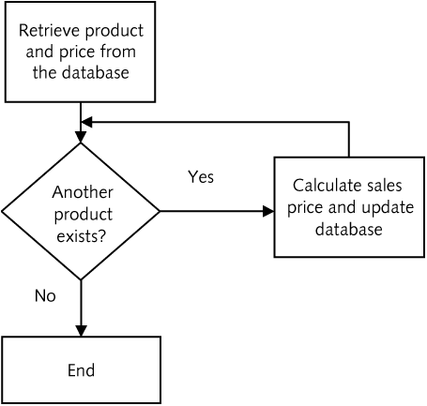
Looping Structures
Oracle11g: PL/SQL Programming

Slide 8
PL/SQL Block Questions
What is a block?
What are the different segments of a block?
How does data get into a block?
How are different data types handled?
Oracle11g: PL/SQL Programming

Slide 9
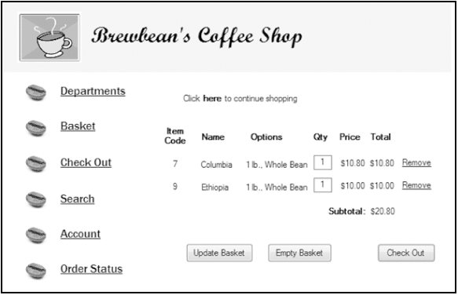
Brewbean’s Challenge
Oracle11g: PL/SQL Programming

Slide 10
PL/SQL Block Structure
DECLARE – create variables, cursors, and types
BEGIN – SQL, logic, loops, assignment statements
EXCEPTION – error handling
END – close the block
Oracle11g: PL/SQL Programming

Slide 11
Variable Names
Begin with alpha character
Up to 30 characters
Can contain upper and lowercase letters, numbers, _ , $ , #
Oracle11g: PL/SQL Programming

Slide 12
Scalar Variable Data Types
Character – CHAR(n)
VARCHAR2(n)
Numeric – NUMBER(p,s)
Date – DATE
Boolean – BOOLEAN
Note: Only holds a single value
Oracle11g: PL/SQL Programming

Slide 13
Example Scalar Declarations
DECLARE
lv_ord_date DATE;
lv_last_txt VARCHAR2(25);
lv_qty_num NUMBER(2);
lv_shipflag_bln BOOLEAN;
BEGIN
---- PL/SQL executable statements ----
END;
Note: Minimum requirements are variable name and data type
Oracle11g: PL/SQL Programming

Slide 14
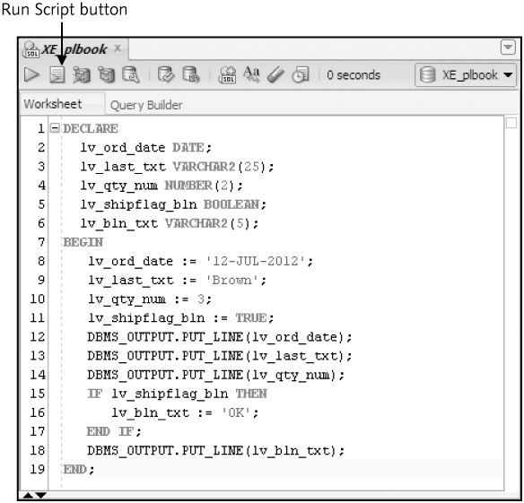
Test Variables
Oracle11g: PL/SQL Programming

Slide 15
Variable Initialization
Set a variable value when the variable
is created
DECLARE
lv_ord_date DATE := SYSDATE;
lv_last_txt VARCHAR2(25) := 'Unknown';
lv_qty_num NUMBER(2) := 0;
lv_shipflag_bln BOOLEAN := FALSE;
BEGIN
---- PL/SQL executable statements ----
END;
Oracle11g: PL/SQL Programming

Slide 16
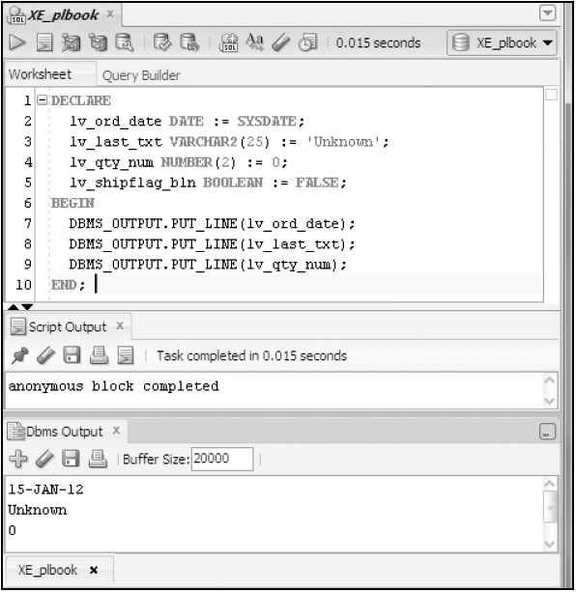
Test Variable Initialization
Oracle11g: PL/SQL Programming

Slide 17
Variable Declaration Options
NOT NULL – the variable must always contain a value
CONSTANT – the variable value can not be changed in the block
DECLARE
lv_shipcntry_txt VARCHAR2(15) NOT NULL := 'US';
lv_taxrate_num CONSTANT NUMBER(2,2) := .06;
BEGIN
---- PL/SQL executable statements ----
END;
Oracle11g: PL/SQL Programming

Slide 18
Calculations with Scalar Variables
multiplication
DECLARE
lv_taxrate_num CONSTANT NUMBER(2,2) := .06;
lv_total_num NUMBER(6,2) := 50;
lv_taxamt_num NUMBER(4,2);
BEGIN
lv_taxamt_num := lv_total_num * lv_taxrate_num;
DBMS_OUTPUT.PUT_LINE(lv_taxamt_num);
END;
/
Oracle11g: PL/SQL Programming

Slide 19
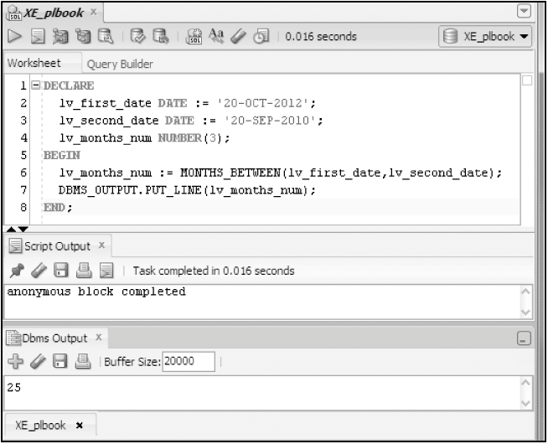
Using SQL Functions
SQL functions such as MONTHS_BETWEEN can be used
within PL/SQL statements
Oracle11g: PL/SQL Programming

Slide 20
Decision Structures
Control which statements in a PL/SQL block will execute
Enables conditions to be tested to determine the flow of statement execution
Most programming languages provide IF and CASE statements to enable conditional processing
Oracle11g: PL/SQL Programming

Slide 21
Decision Structures (continued)
IF Statements
  Simple IF
  IF/THEN/ELSE
  IF/THEN/ELSIF/ELSE
CASE Statements
  Basic CASE statement
  Searched CASE statement
  CASE expression
Oracle11g: PL/SQL Programming

Slide 22
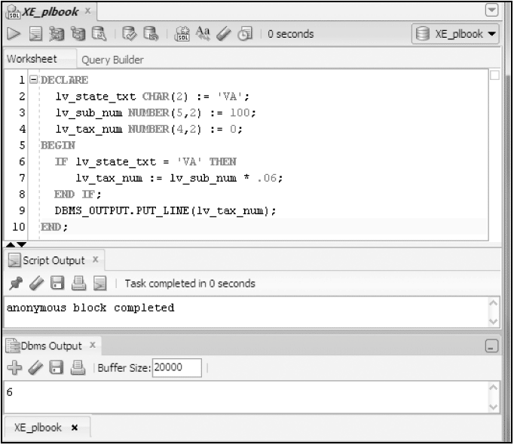
Basic IF Statement
Oracle11g: PL/SQL Programming

Slide 23
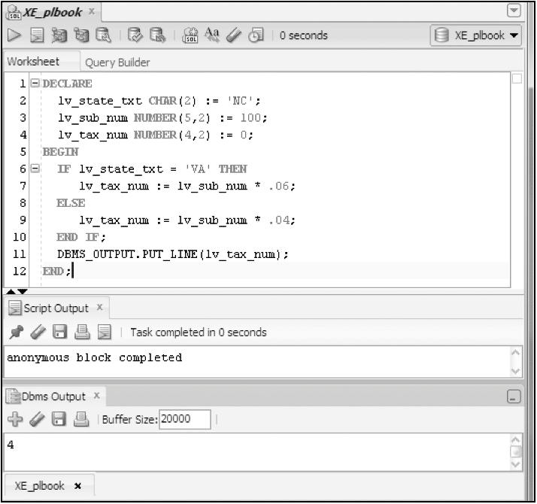
IF/THEN/ELSE
Oracle11g: PL/SQL Programming

Slide 24
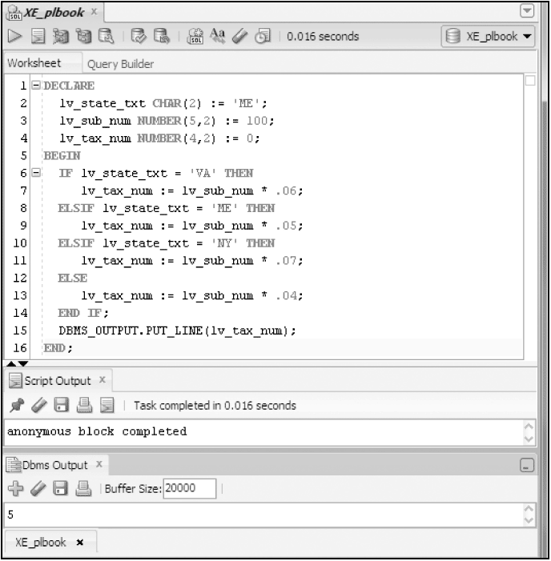
IF/THEN/ELSIF/ELSE
Oracle11g: PL/SQL Programming

Slide 25
Nested IF
IF lv_type_txt = 'E' THEN
IF lv_price_num > 85 THEN <-- Inner or nested IF begins
lv_disc_num = .20;
ELSIF lv_price_num > 45 THEN
lv_disc_num = .15;
ELSE
lv_disc_num = .10;
END IF; <-- Inner or nested IF ends
ELSIF lv_type_txt = 'C' THEN
lv_disc_num = .05;
END IF;
Oracle11g: PL/SQL Programming

Slide 26
Logical Operators within IF
Logical operators (AND, OR) enable multiple conditions to be checked
IF lv_state_txt = 'VA' OR lv_state_txt = 'PA' THEN
lv_tax_num := lv_sub_num * .06;
ELSE
lv_tax_num := lv_sub_num * .04;
END IF;
Oracle11g: PL/SQL Programming

Slide 27
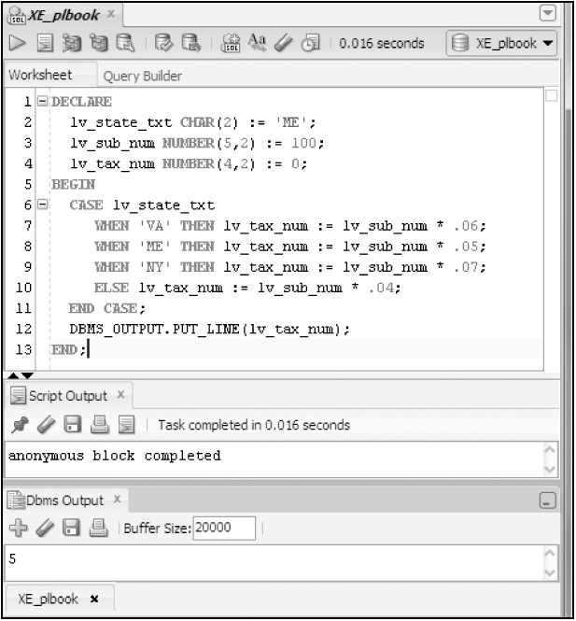
Basic CASE Statement
Oracle11g: PL/SQL Programming

Slide 28
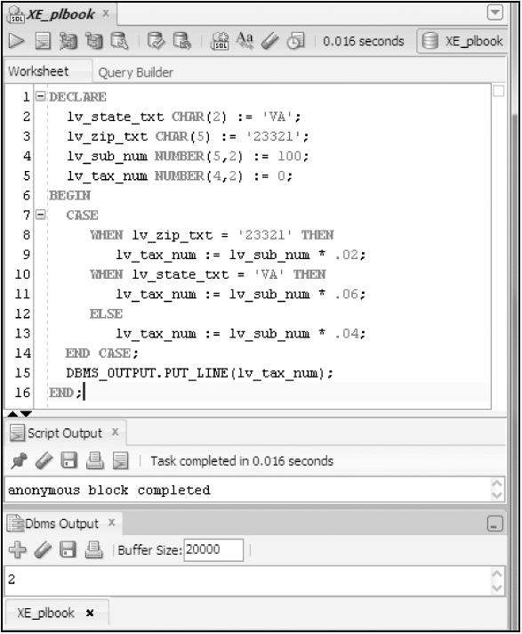
Searched CASE
Oracle11g: PL/SQL Programming

Slide 29
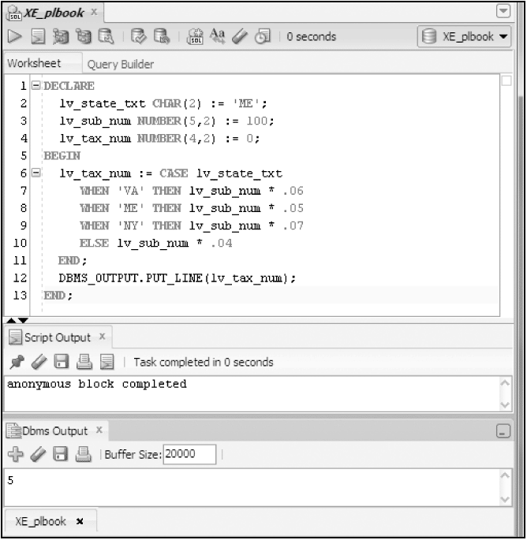
CASE Expression
Oracle11g: PL/SQL Programming

Slide 30
Looping
Enables a statement or set of statements to be executed more than once
A loop must provide instructions of when to end the looping, or an ‘infinite’ loop will be produced
Oracle11g: PL/SQL Programming

Slide 31
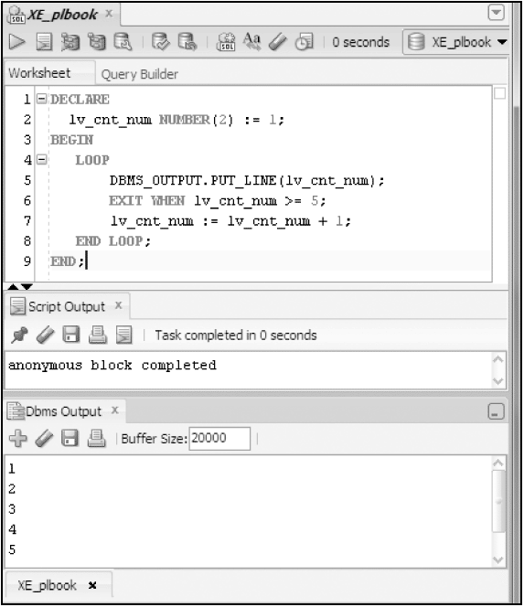
Basic LOOP
Oracle11g: PL/SQL Programming

Slide 32
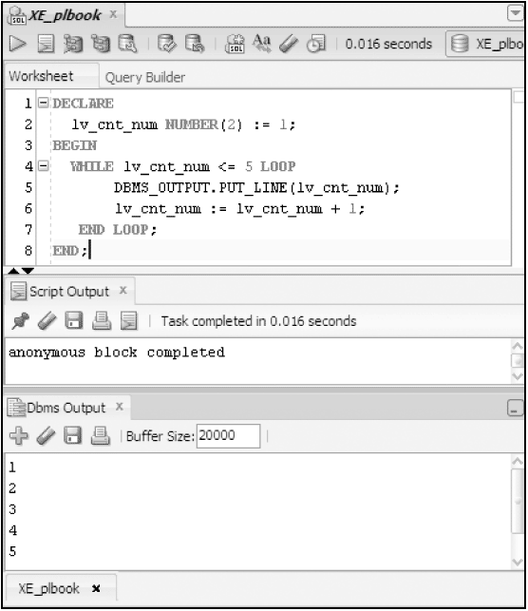
WHILE Loop
Oracle11g: PL/SQL Programming

Slide 33
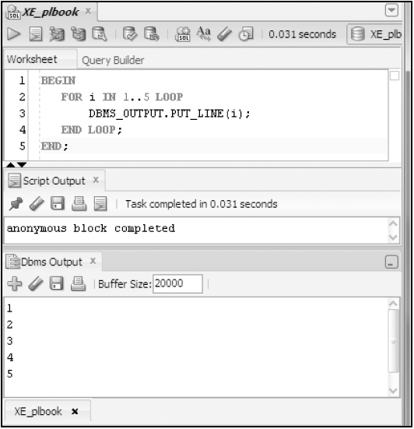
FOR Loop
Oracle11g: PL/SQL Programming

Slide 34
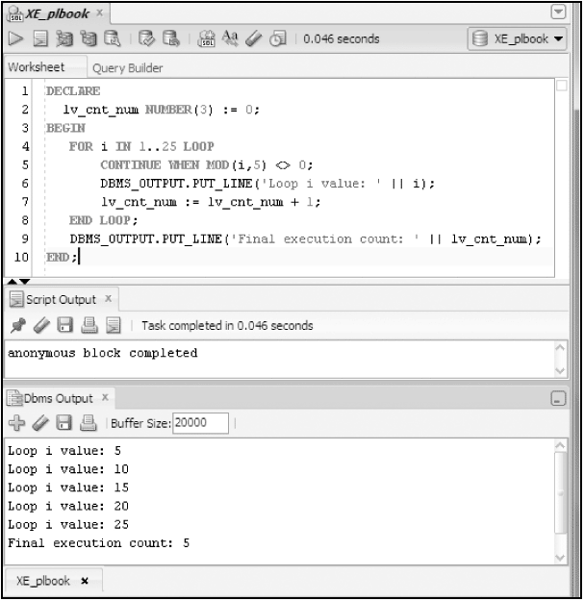
CONTINUE Statement
Oracle11g: PL/SQL Programming

Slide 35
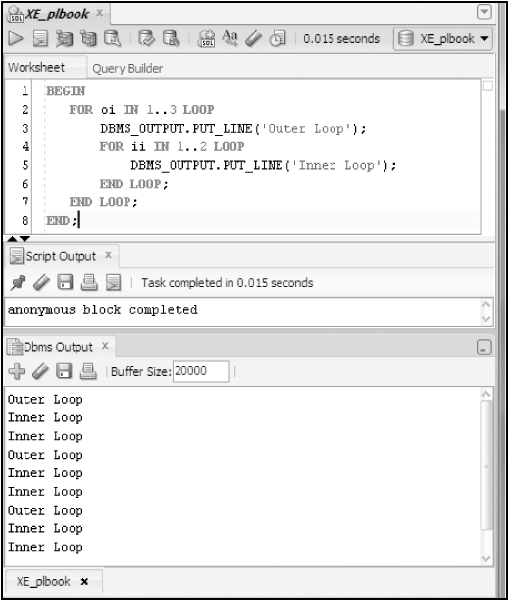
Nested Loops
Oracle11g: PL/SQL Programming

Slide 36
Summary
A flowchart assists in laying out processing logic
A PL/SQL block contains a DECLARE, BEGIN, EXCEPTION, and END sections
Variables to hold values are declared
Scalar variables hold a single data value
Scalar variables can hold string values, numbers, dates, and Boolean values
DBMS_OUTPUT.PUT_LINE is used to display values
Oracle11g: PL/SQL Programming

Slide 37
Summary (continued)
IF statement structure is IF/THEN/ELSIF/ELSE
CASE statements provide decision processing similar to IF statements
Looping structures include: basic, WHILE, and FOR
Host or bind variables can be used to interact with the application environment
Oracle11g: PL/SQL Programming

